Slide 1

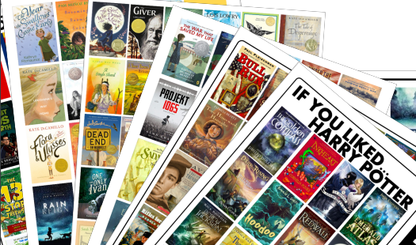
HOLLY LODGE GIRLS’ COLLEGE
Reading at Holly Lodge Girls’ College:
Information for Parents

Slide 2
At Holly Lodge Girls’ College, our aim is that students read with fluency and skill to maximise learning potential across the curriculum. We aim to foster a love of reading for pleasure so that our students become lifelong readers.
Reading for Pleasure:
We are constantly looking for a range of ways to encourage and nurture a love of reading. We offer a vast range of reading related activities designed to promote a love of reading, such as:
World Book Day activities such as Guess the Reader, sponsored reads, short stories during break-times and online author workshops
Empathy Day events and workshops
Book clubs
Liverpool Reads events and guest speakers
Black History month nonfiction texts
Readathon
Book Swaps
Poetry and writing competitions
Author visits
Debate Mate
We also have a hugely successful Silver Stories initiative, where pupils read a range of poetry, letters, prose and nonfiction to the residents of a retirement home
Look out for our range of special after-school events such as Speed-Reading, Banned Books and Empathy Reads.

Slide 3
Day to day reading in Holly Lodge Girls’ College:
In addition to the varied and engaging reading opportunities provided in all subjects, we also provide the following reading routines:
Every form group in years 7-10 take part in reading during form time, twice a week. The form tutor reads with students, modelling effective expression and delivery. Each book is accompanied with vocabulary and definitions to aid understanding and vocabulary development.
We have a designated reading room, where students can read and borrow books during break, lunch-times and before or after school.

Slide 4
Additional Reading Support:
Students across years 7 to 10 undertake a yearly Reading Age assessment to identify any potential reading support needs. Should your child require any additional support, they may be invited, to access one or more of the following, which are all led and facilitated by a specialist English teacher:
Lexonik Leap sessions: these are 20-minute-long sessions designed to improve decoding and phonic understanding. They are conducted at least three times a week, often during form time.
1 to 1 support: For pupils in year 7 that have completed the Lexonik Leap sessions, or may benefit from reading practice, they may receive 30-minute sessions on a one-to-one basis. During this time, they will build on the learning from Lexonik Leap and combine it with comprehension strategies to help develop word recognition, and fluency.
Comprehension Plus: For students who have some difficulties with comprehension, we have a range of age/level appropriate reading books (Rapid Plus) which have inbuilt vocabulary and comprehension style questions. Students will attend these sessions in groups of four for an hour a week.
Reading Development Course: Throughout course of the year, a significant number of pupils will take part in a reading development programme, which will take place during form-time, in groups of approximately 20 students. Students will practise a range of comprehension, choral, echo and paired reading strategies to boost fluency and automaticity.
Lexonik Advance sessions: these are hourly sessions which take place over a consecutive six-week period. It is predominantly delivered to light green readers and is a vocabulary-based programme focusing on the etymology and morphology of words.
This support is provided in addition to any relevant SEN provision your child may require.

Slide 5
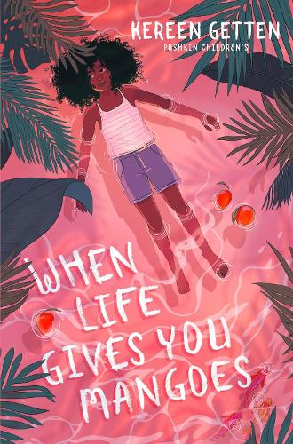
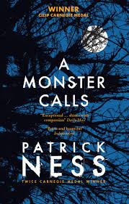
Year 7 Form Reading Books
Nothing much happens in Sycamore, the small village where Clara lives - at least, that's how it looks. She loves eating ripe mangoes fallen from trees, running outside in the rainy season and escaping to her secret hideout with her best friend Gaynah. There's only one problem - she can't remember anything that happened last summer.
When a quirky girl called Rudy arrives from England, everything starts to change. Gaynah stops acting like a best friend, while Rudy and Clara roam across the island and uncover an old family secret. As the summer reaches its peak and the island storms begin, Clara's memory starts to return and she must finally face the truth of what happened last year.
Thirteen-year-old Conor O’Malley Conor is dealing with far more than other boys his age. His beloved and devoted mother is terminally ill with cancer. He has little in common with his grandmother. His father has resettled thousands of miles away. But Conor finds a most unlikely ally when the Monster appears at his bedroom window one night. Ancient, wild, and relentless, the Monster guides Conor on a journey of courage, faith, and truth that powerfully fuses imagination and reality.
Contains depictions of grief and terminal illness.

Slide 6
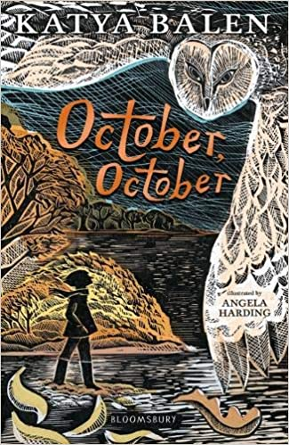
Year 7 Form Reading Books
October and her dad live in the woods. They sleep in the house Dad built for them and eat the food they grow in the vegetable patches. They know the trees and the rocks and the lake and stars like best friends. They read the books they buy in town again and again until the pages are soft and yellow - until next year's town visit. They live in the woods and they are wild.
And that's the way it is.
Until the year October turns eleven. That's the year October rescues a baby owl. It's the year Dad falls out of the biggest tree in their woods. The year the woman who calls herself October's mother comes back. The year everything changes

Slide 7
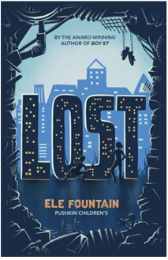

When their father fails to come home one day, Lola and Amit face a terrifying new reality. With no money and no idea how to look after themselves, they are made homeless and must find a way to survive on the streets.
Things go from bad to worse when Lola and Amit are separated. In a race to find her brother, Lola must rely on the help of Rafi - a boy who, like her, is struggling to endure homelessness. Thrilling and hard-hitting in equal measure, Lost is a rich adventure story with urgent social themes.
Year 8 Form Reading Books
When their father fails to come home one day, Lola and Amit face a terrifying new reality. With no money and no idea how to look after themselves, they are made homeless and must find a way to survive on the streets.
Things go from bad to worse when Lola and Amit are separated. In a race to find her brother, Lola must rely on the help of Rafi - a boy who, like her, is struggling to endure homelessness. Thrilling and hard-hitting in equal measure, Lost is a rich adventure story with urgent social themes.
Explores themes such as grief and poverty.
Twelve-year-old Jerome is shot by a police officer who mistakes his toy gun for a real threat. He then becomes a ghost and watches what happens to his family as a result.
Soon Jerome meets another ghost: Emmett Till, a boy from a very different time but similar circumstances. Emmett helps Jerome process what has happened, on a journey towards recognizing how historical racism may have led to the events that ended his life. Jerome also meets Sarah, the daughter of the police officer, who struggles with her father’s actions.
Explores themes such as grief and racism.

Slide 8

Year 8 Form Reading Books
Helen has just moved in with her dorky dad and self-absorbed older siblings - who just happen to be Greek gods, living incognito in London! It's hard not to feel inferior when your older sister is Aphrodite, queen of beauty and massive star of social media. Not to mention introducing a boy to your dad when he's really Zeus.
Between keeping her family's true identities secret, trying to impress her new friends, and meeting Marco, an actually cute boy, Helen's stress levels are higher than Mount Olympus.
Especially as it seems like someone is determined to expose the family secret and have them banished from the mortal world.
Can Helen find a way to save her family, or will she lose them forever?

Slide 9


A secret from her past threatens to detonate her present... On her first day at a new school, Ruby finds a note in her locker saying I Know You Did It. She's terrified that someone has found out she was responsible for the death of a girl called Hannah in a playground when they were both toddlers - a secret she has been keeping guiltily for ten years. When other pupils at the school start suffering serious accidents, the finger of blame points at Ruby. She knows she's not the perpetrator, but who is? And what link do they have to her past...?
Year 9 Form Reading Books
Romania, 1989. Communist regimes are crumbling across Europe. Seventeen-year-old Cristian Florescu dreams of becoming a writer, but Romanians aren’t free to dream; they are bound by rules and force.
Amidst the tyrannical dictatorship of Nicolae Ceaușescu in a country governed by isolation and fear, Cristian is blackmailed by the secret police to become an informer. He’s left with only two choices: betray everyone and everything he loves—or use his position to creatively undermine the most notoriously evil dictator in Eastern Europe.
Cristian risks everything to unmask the truth behind the regime, give voice to fellow Romanians, and expose to the world what is happening in his country. He eagerly joins the revolution to fight for change when the time arrives. But what is the cost of freedom?
Includes occasional strong language and some depictions of violence.
A secret from her past threatens to detonate her present... On her first day at a new school, Ruby finds a note in her locker saying I Know You Did It. She's terrified that someone has found out she was responsible for the death of a girl called Hannah in a playground when they were both toddlers - a secret she has been keeping guiltily for ten years. When other pupils at the school start suffering serious accidents, the finger of blame points at Ruby. She knows she's not the perpetrator, but who is? And what link do they have to her past...?
Includes ooccasional strong language and some depictions of violence.

Slide 10
Year 9 Form Reading Books
Kiss the Dust is a book written by Elizabeth Laird on the conflicts between the Iraqi Kurds and Saddam Hussein's regime. It is a young adult historical fiction novel about a twelve-year-old Kurdish girl and her family's escape from Iraq over the border into Iran.
Includes some depictions of violence.

Slide 11


a young adult novel about a wealthy, seemingly perfect family, the Sinclairs, who summer on their private island. The story centers on Cadence Sinclair Eastman, who experiences an accident during her fifteenth summer and suffers from amnesia. Two years later, she returns to the island determined to uncover the truth of what happened that summer, piecing together fragmented memories and facing the lies and secrets within her family. The novel explores themes of family, memory, privilege, and the destructive nature of secret
Year 10 Form Reading Books
A young adult novel about a wealthy, seemingly perfect family, the Sinclairs, who summer on their private island. The story centres on Cadence Sinclair Eastman, who experiences an accident during her fifteenth summer and suffers from amnesia. Two years later, she returns to the island determined to uncover the truth of what happened that summer, piecing together fragmented memories and facing the lies and secrets within her family. The novel explores themes of family, memory, privilege, and the destructive nature of secret.
Includes some strong language.
From Penguin's The Originals collection, The Outsiders is an outstanding story of teenage rebellion, written when the author was only 17.
Teenagers in a small Oklahoma town have split into two gangs, divided by money, tastes and attitude. The Socs' idea of having a good time is beating up Greasers like Ponyboy Curtis.
Ponyboy knows what to expect and knows he can count on his brothers and friends - until the night someone takes things too far, and life is changed forever.
Includes some depictions of violence.

Slide 12
HOLLY LODGE GIRLS’ COLLEGE
In addition to the reading room at Holly Lodge, another easy and free way of accessing thousands of eBooks and audiobooks is via Liverpool’s online library. If you or your child are already a member, you can download the app Libby and enter your membership number to borrow a range of online texts. If you are not a member, it is simple to apply for membership here: https://www.readliverpool.co.uk/ebooks/ .
It takes a matter of minutes and will provide you with an online membership card.
You could also browse https://www.lovereading4kids.co.uk/ which provides lots of book recommendations and reviews.
Should you have any further queries or concerns regarding your child’s reading, please contact:
Whole School Reading co-ordinator:
Mrs A Edwards
a.edwards@hollylodge.liverpool.sch.uk
Literacy co-ordinators:
Mrs L Scott
l.scott@hollylodge.liverpool.sch.uk

