Slide 1
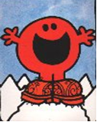


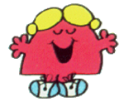


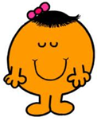


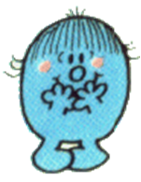

COMMENT ES-TU? – WHAT ARE YOU LIKE?
CHATTY | CHATTY | GREEDY | GREEDY | LAZY
 | le recyclage
bavard
bavarde
gourmand
gourmande
paresseux
LAZY | ACTIVE | ACTIVE | EXTROVERT | SHY
 | le recyclage
paresseuse
actif
active
extraverti(e)
timide

Slide 2



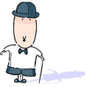


COMMENT ES-TU? – WHAT ARE YOU LIKE?
SHORT | TALL | FUNNY | FUNNY | SPORTY
 | le recyclage
petit(e)
grand(e)
marrant
marrante
sportif
SPORTY
 | le recyclage
sportive

Slide 3


Comment es-tu?
What are you like?
Je suis….
Je ne suis pas

Slide 4
Translate these sentence into English
Je suis
Je ne suis pas……
1. Je suis bavarde
I am chatty.
2. Je suis paresseuse.
I am lazy.
3. Je ne suis pas gourmande.
I am not greedy.
4. Je ne suis pas marrante.
I am not funny.

Slide 5

How can I improve my work?
It’s as easy as………
1
2
3
Basic Connectives
Quantifiers
Adverbs of frequency and time

Slide 6
How can I improve my work?
1
Basic Connectives
et = and
aussi = as well
mais = but
1. Je suis marrante et je suis active aussi.
I am funny and I am active as well.
2. Je suis bavarde mais je ne suis pas extravertie.
I am chatty but I am not extrovert.

Slide 7
How can I improve my work?
2
Quantifier
Très - very
Assez – quite
Un peu – a little
1. Je suis très grande et assez sportive.
I am very tall and quite sporty.
2. Je suis assez paresseuse et un peu bavarde.
I am quite lazy and a little chatty.

Slide 8
How can I improve my work?
3
Adverbs of frequency and time
En général – generally
Normalement – normally
Souvent – often
Toujours - always
1. En général je suis bavarde
Generally I am chatty.
2. Je suis toujours marrante.
I am always funny.
3. Normalement je suis timide.
Normally I am shy.

Slide 9


Let’s put this all together
1
+
2
+
3
=
Higher level sentences

Slide 10
TRY THESE HIGHER LEVEL SENTENCES
Normalement je suis très très bavarde mais je ne suis pas du tout extravertie.
Normally I am very very chatty but I am not at all extrovert.
En général je suis un peu timide et je suis assez petite aussi
Generally I am a little shy and I am quite small also
Je suis souvent très marrante, assez gourmande et un peu paresseuse, mais de temps en temps je suis assez active.
I am often very funny, quite greedy and a little lazy, but
from time to time I am quite active.

Slide 11
CHECKLIST
I know most personality words from memory.
I can use basic connectives to make my
sentences more complex.
I can use quantifiers correctly.
I can use adverbs of time and frequency in
my sentences.
I can understand higher level sentences.
BONNE CHANCE

