Slide 1
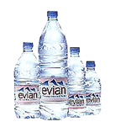
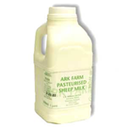
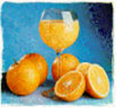
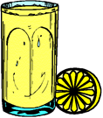


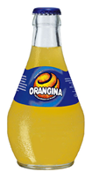

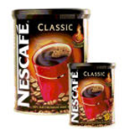
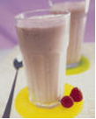
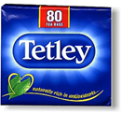
LES BOISSONS - DRINKS
MINERAL WATER | A BOTTLE OF MILK | ORANGE JUICE | LEMONADE | HOT CHOCOLATE
 | le recyclage
de l’eau minérale
du lait
un jus d’orange
une limonade
un chocolat chaud
COKE | BLACK / WHITE COFFEE | MILKSHAKE | (WHITE) TEA | ORANGEADE
 | le recyclage
un coca cola
un café
(au lait / crème)
un milkshake
un thé
(au lait)
un orangina

Slide 2
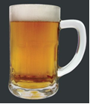
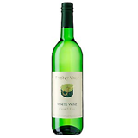

LES BOISSONS - DRINKS
BEER | WHITE WINE | RED WINE
 | le recyclage
une bière
du vin blanc
du vin rouge

Slide 3
Qu’est-ce que tu aimes boire ?
What do you like to drink ?
In order to answer this question you need to know the expressions for likes and dislikes off by heart.

Slide 4
SEE HOW MANY EXPRESSIONS YOU KNOW ALREADY
J’aime
I like
I really like
J’aime beaucoup
I love
J’adore
I prefer
Je préfère

Slide 5

SEE HOW MANY EXPRESSIONS YOU KNOW ALREADY
Je n’aime pas
I don’t like
Je n’aime pas du tout
I don’t like….at all
I hate
Je déteste
Je ne préfère pas
I do not prefer

Slide 6
When saying which drink you like, in French you must use the word ‘the’.
In English we say: ‘I like Coke’
But in French you MUST say: ‘I like the Coke’
This applies to ANY drink you like or dislike.
J’aime le coca
Je n’aime pas le lait
I like Coke
I do not like milk

Slide 7
CAN YOU TRANSLATE THESE SENTENCES?
1. J’aime le café..
I like coffee
2. J’adore le coca.
I love Coke.
3. Je n’aime pas le lait.
I do not like milk.
4. Je déteste le jus de tomate.
I hate tomato juice.

Slide 8

USE BASIC CONNECTIVES TO MAKE YOUR SENTENCES MORE COMPLEX
ET
MAIS
AUSSI
AND
BUT
AS WELL

Slide 9
CAN YOU TRANSLATE THESE SENTENCES?
1. J’aime le café et j’aime le thé aussi..
I like coffee and I like tea as well.
2. J’adore le coca mais je déteste l’Orangina.
I love Coke but I hate orangeade.
3. Je n’aime pas le lait mais j’adore le chocolat chaud.
I do not like milk but I love hot chocolate.
4. Je déteste le jus de tomate et le café aussi.
I hate tomato juice and coffee as well.

Slide 10
REASONS
PARCE QUE…..
1. c’est trop sucré.
2. c’est sucré.
3. c’est dégoûtant.
c’est amer
5. c’est bon pour la santé.
6. c’est rafraîchissant.
BECAUSE…..
it’s good for your health.
it’s bitter.
it’s refreshing.
it’s disgusting.
it’s too sweet.
it’s sweet.
e. it’s too sweet
f. it’s sweet.
d. it’s disgusting.
b. it’s bitter.
a. it’s good for your health.
c. it’s refreshing.

Slide 11


TRY THESE HIGHER LEVEL SENTENCES
1. J’aime le coca parce que c’est sucré..
I like Coke because it is sweet
J’adore le jus d’orange parce que c’est bon pour la santé.
I love orange juice because it is good for your health
3. Je n’aime pas le lait parce que, à mon avis, c’est trop sucré.
I do not like milk because, in my opinion, it is too sweet.
Je déteste la bière parce que, à mon avis, c’est dégoûtant.
I hate beer because, in my opinion, it is disgusting.

Slide 12
VARIETY
When preparing for your Controlled Writing & Speaking Assessments, if you say j’aime in one sentence, the next time you want to say you like something, choose a different way of saying it e.g. j’aime beaucoup or j’adore.
Use a variety of likes and dislikes and expressions. This will show the examiner that you have a good knowledge of French and it will earn you a higher mark.
There are other ways of talking about what you drink and what drinks you like and do not like. For example:
say what you drink in the morning/afternoon / evening
say what you like to drink (and when)
say what you drink when you are thirsty
GOOD VARIETY = GOOD MARKS

Slide 13
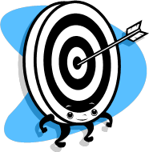
HIGHER LEVEL likes and dislikes
By putting ‘ce que’ BEFORE a like or dislike, and ‘c’est’ AFTER - a HIGHER LEVEL structure is created e.g.
Ce que j’aime c’est
Ce que j’adore c’est
Ce que je n’aime pas c’est
Ce que je déteste c’est
What I like is
What I love is
What I don’t like is
What I hate is

Slide 14
KEY VERBS & PHRASES
The two key verbs you need to say what you drink are:
BOIRE
PRENDRE
Je bois = I drink
Je prends = I have
( with food & drink)
Say WHEN you drink:
Le matin
L’après-midi
Le soir
Le week-end
Quand j’ai soif
In the morning
J’aime boire
= I like to drink
Je n’aime pas prendre
= I do not like to have
In the afternoon
In the evening
At the weekend
When I am thirsty

Slide 15
TRY THESE HIGHER LEVEL SENTENCES
Le matin, j’adore prendre un jus d’orange parce que c’est
bon pour la santé et c’est ma boisson préférée aussi.
In the morning, I love to have an orange juice because it
good for your health and it is also my favourite drink.
Quand j’ai très soif, j’adore boire un coca parce que c’est très rafraîchissant.
When I am very thirsty, I love to drink a Coke because it is
very refreshing.
Le soir, ce que j’adore c’est prendre un chocolat chaud avant de me coucher mais ma mère dit que c’est trop sucré.
In the evening, what I love is to have a hot chocolate
before going to bed but my mum says it is too sweet..

Slide 16
CHECKLIST
I know most drinks from memory.
I can say which drinks I (dis)like + say why.
I can say WHEN I have my drinks.
I can use basic connectives to make my
sentences more complex.
I can use higher level structures.
BONNE CHANCE

