Slide 1
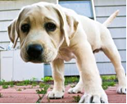
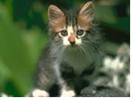
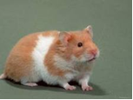
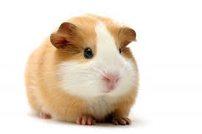
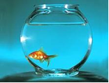

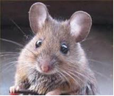
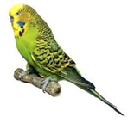
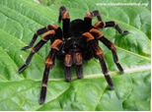
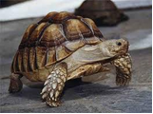
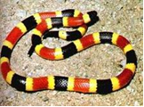
LES ANIMAUX - ANIMALS
DOG | CAT | HAMSTER | GUINEA PIG | FISH
 | le recyclage
un chien
un chat
un hamster
un cochon d’Inde
un poisson
SNAKE | MOUSE | BIRD | SPIDER | TORTOISE
 | le recyclage
un serpent
une souris
un oiseau
une araignée
une tortue

Slide 2





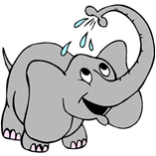
LES ANIMAUX - ANIMALS
HORSE | PARROT | RAT | TIGER | LION
 | le recyclage
un cheval
un perroquet
un rat
un tigre
un lion
ELEPHANT
 | le recyclage
un éléphant

Slide 3


Est-ce que tu as un animal à la maison?
Do you have a pet?
Oui, j’ai……
Non, je n’ai pas d’animal

Slide 4
Translate these sentence into English
J’ai……
Je n’ai pas de……
1. J’ai un poisson rouge.
I have a goldfish.
2. J’ai deux chats.
I have two cats.
3. Je n’ai pas de chien.
I do not have a dog.
4. Je n’ai pas de lapin.
I do not have a rabbit.

Slide 5

How can I improve my work?
It’s as easy as………
1
2
3
Basic Connectives
Name
Say what pets your brothers/sisters/friends have

Slide 6
How can I improve my work?
1
Basic Connectives
et = and
aussi = as well
mais = but
1. J’ai un hamster et deux lapins aussi.
I have a hamster and two rabbits as well.
2. J’ai deux chats mais je n’ai pas de chien.
I have two cats but I do not have a dog.

Slide 7

How can I improve my work?
2
Name
Qui s’appelle = which is called
Qui s’appellent = which are called
1. J’ai un hamster qui s’appelle Squeak.
I have a hamster which is called Squeak.
2. J’ai deux chats qui s’appellent Snowy and Browny.
I have two cats which are called Snowy and Browny.

Slide 8
How can I improve my work?
3
Say what pets
your brothers /
sisters/ friends
have
Mon frère a = my brother has
Ma soeur a = my sister has
Mon copain a = my friend has
Ma copine a = my friend has
1. Mon frère a une araignée.
My brother has a spider.
2. Ma soeur a un perroquet.
My sister has a parrot.
3. Ma copine a un cochon d’Inde.
My friend has a guinea pig.

Slide 9


Let’s put this all together
1
+
2
+
3
=
Higher level sentences

Slide 10
TRY THESE HIGHER LEVEL SENTENCES
Mon frère a deux chats qui s’appellent Snowy & Browny et ma soeur a un lapin qui s’appelle Fluffy.
My brother has two cats which are called Snowy and
Browny and my sister has a rabbit which is called Fluffy.
J’ai un chien qui s’appelle Rover mais mon frère n’a pas d’animal.
I have a dog which is called Rover but my brother does not
have a pet.
Je n’ai pas d’animal mais ma meilleure copine a un cheval qui
s’appelle Red Rum .
I do not have a pet but my best friend has a horse which is
called Red Rum.

Slide 11
CHECKLIST
I know most animals from memory.
I can use basic connectives to make my
sentences more complex.
I can say what the pets are called.
I can say which pets my brothers, sisters
and friends have.
I can understand higher level sentences.
BONNE CHANCE

