Slide 1

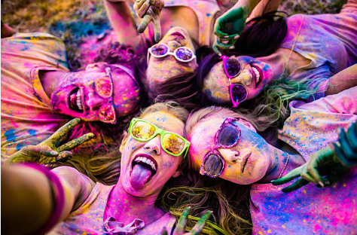
Session 8
Friendships and fallouts

Slide 2
Welcome to Session 8 – we only have one more session together after this!
Last time we looked at ‘what is normal anyway?’
I hope you are able to recognise that no one is normal.
We are all wonderfully unique.
We all have things we like about ourselves and things we don’t.
There is no point in trying to be someone else.
Be the best YOU that you can be!

Slide 3
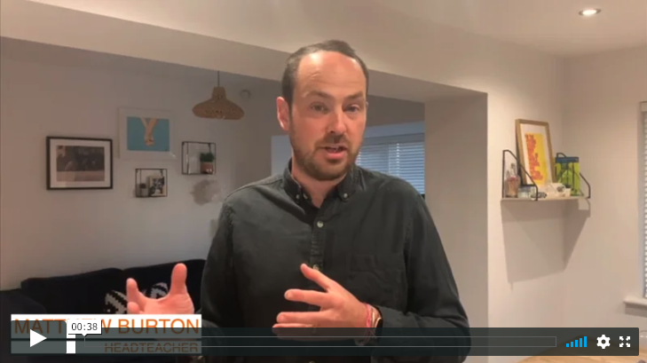

Today we are looking at ‘friendships and fallouts’ – one of the tricky areas of growing up. Here is Matthew to explain some more…
Read from page 84 to page 117, if you have a copy of ‘Go Big’.

Slide 4
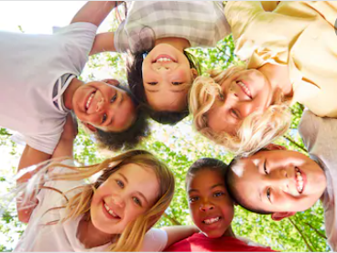
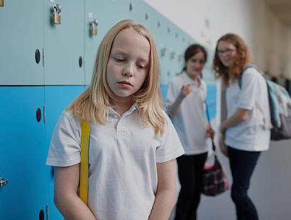
At secondary school, you will make new friends and also still have old friends.
At times, friendships can be difficult…

Slide 5
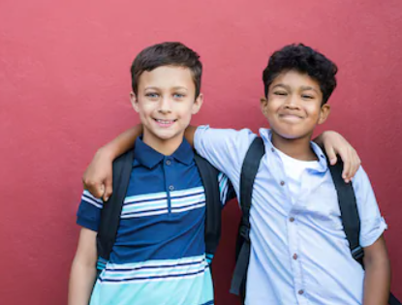
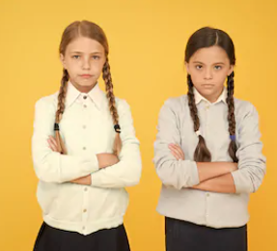
You may have arguments and even change some friendships along the way…
But making good impressions will help you build new relationships with others.

Slide 6
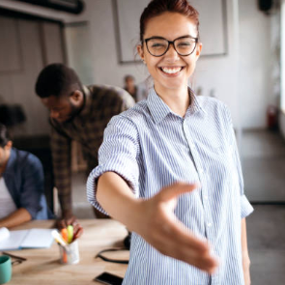
Did you know that a first impression is very hard to change?
We therefore need to make good first impressions and be aware that people will be getting a first impression of you!

Slide 7
Here are some top tips from Mr Burton on making a good first impression at secondary school:
Be you – people want honesty from their friends!
Don’t be afraid to make conversation.
Be nice – smile and look up.
Go to clubs that are to do with your interests – you’ll bond with people there.
Give it time – it takes time to make friendships!
Don’t force it – some things are not meant to be!
Be comfortable – meet people where you’ll both be comfortable and can properly chat.
Use your lessons – if you’re sitting next to someone, use it as a chance to chat
(BUT NOT WHEN THE TEACHER IS OR WHEN YOU ARE MEANT TO BE WORKING).

Slide 8
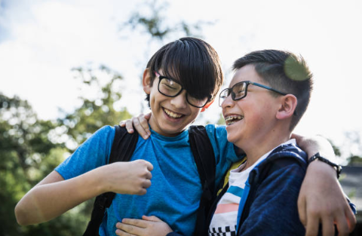
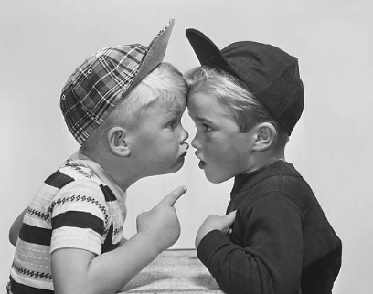
Friendships are important but sometimes they come and go…
…and this is OK. Sometimes we change; sometimes others change.

Slide 9
What kind of friends do you want to have in secondary school? Make a list in your workbook.
What kind of friend do you want to be to other people? Make a list in your workbook.

Slide 10
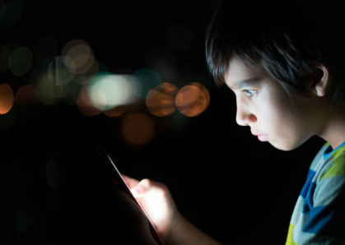
Sometimes things can go wrong…
When using social media and technology, bullying can happen and it can make you or others feel upset, sad and really worried.
ALWAYS tell someone – your parents/carers, your tutor or someone else who you trust. Together, these things can be sorted out and teachers will know how to help you.
Don’t ever forget what costs nothing and can make every single human being’s life just that little bit better every day: KINDNESS.

Slide 11
Sometimes, some friendships are not always the most healthy for us.
“Walk away from friendships that make you feel small and insecure, and seek out people who inspire and support you.”
Michelle Obama
American lawyer, author, activist and former First Lady of the United States
Always seek to BUILD OTHERS UP and not bring them down.

Slide 12
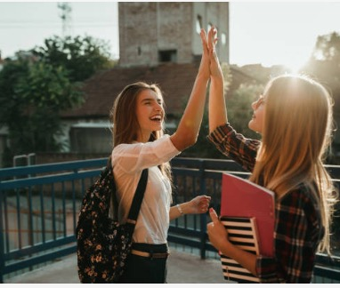
Throughout school and life we all change…
…this means our friends might change too.

Slide 13
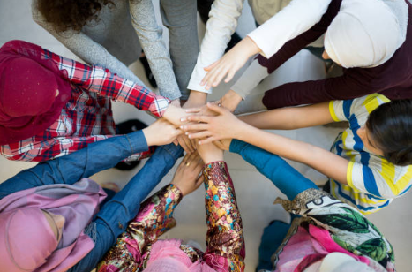
Activity: Your friendships
Who makes you laugh?
Who is a good listener?
Who can you trust?
Who will give you an honest opinion?
Who will help you get through the transition to secondary school?

Slide 14
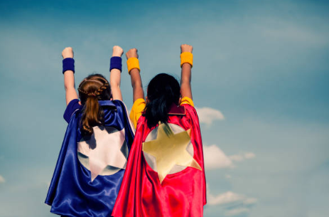
Take this time of going to secondary school to meet new friends
and feel excited.

Slide 15
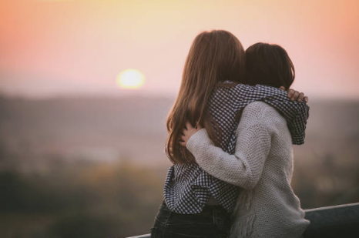
Enjoy being with people who make you happy.
Find people who are your type of people, who treat you right and respect you for being the person you are.
Why? Because you’re brilliant, and you deserve to be respected.

Slide 16
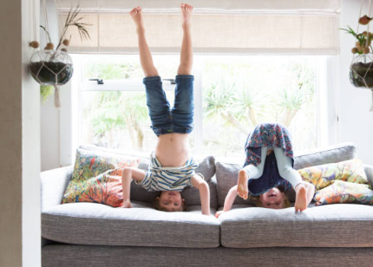
Find people who make you feel good.
Try to make other people feel good too.
Smile and be kind.

Slide 17
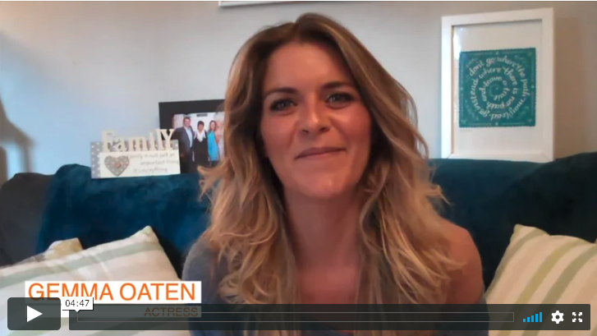
Here is Gemma’s take on friendships and fallouts:

Slide 18
© 2020 The PiXL Club Ltd and Hachette UK
This resource may be shared with any primary school Year 6 student in its current form, and parts thereof, to enhance your transition work with students. All opinions and contributions are those of the authors. The contents of this resource are not connected with, or endorsed by, any other company, organisation or institution.
If there are any inadvertent omissions or errors in the acknowledgements or usage, this is unintended and we will remedy these on written notification.
Hachette UK own 'You Are Awesome' by Matthew Syed and 'Go Big' by Matthew Burton, which may be purchased by individuals and schools, should they wish to do so to enhance these resources for students. 'You Are Awesome' illustrations copyright © Toby Triumph. 'Go Big' illustrations copyright © Chris Madden.

