Slide 1
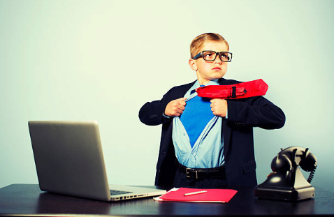

Session 4
Making the change

Slide 2
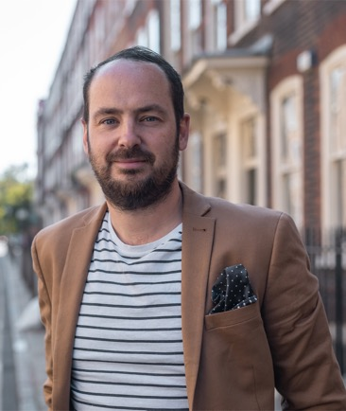
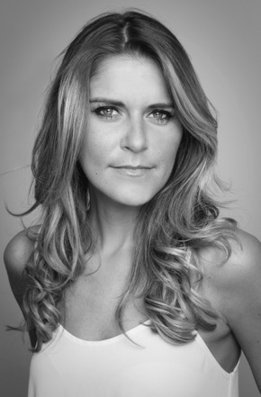
Welcome to Session 4. We have a new person who is going to help us for the rest of these sessions and that’s Matthew Burton. Matthew is an author, TV presenter (occasionally on BBC Bitesize) and starred in ‘Educating Yorkshire’. He is also often on TV and radio being interviewed. He is a headteacher and has written ‘Go Big’ to help you as you move on to secondary school. Gemma is still here and will pop up at the end!
Matthew Burton
Gemma Oaten

Slide 3
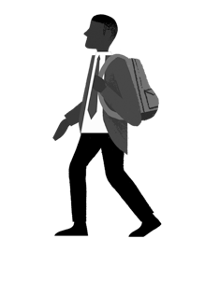
In Session 3, we looked at the things that we worry about including the fear of failure.
We agreed that failure is a way to learn and we should embrace it!
People who want to be awesome and mature, make failure an opportunity to learn.

Slide 4
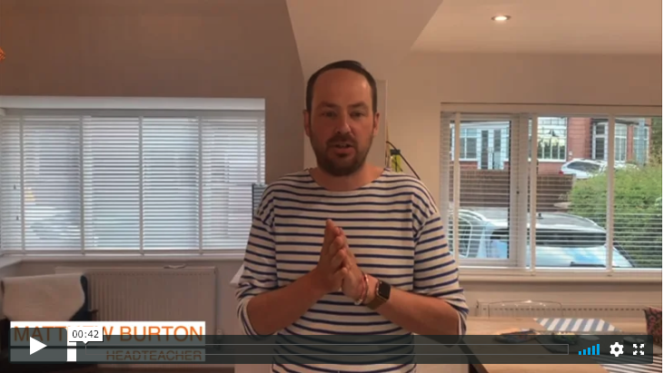

Here is Matthew Burton to introduce today’s session:
We are now looking at Matthew Burton’s book ‘Go Big’. If you are reading alongside these sessions, then you can read up to page 35.

Slide 5
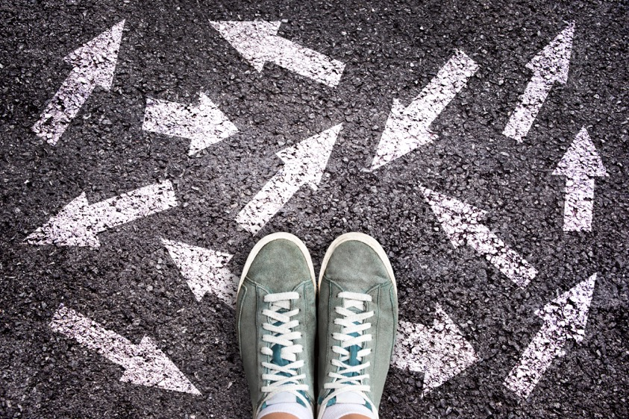
What is change?
In life, we go through many different changes or ‘transitions’. Here are some examples:
Moving house
Becoming a vegetarian
Becoming a brother or sister
Getting your first job
Breaking your leg or arm
Growing up
Going to secondary school

Slide 6
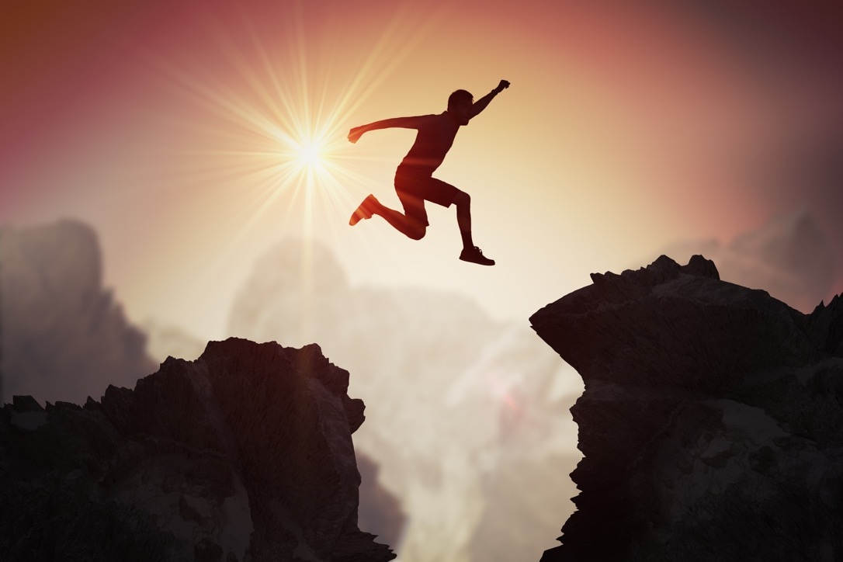
One of the biggest changes you will ever make is the leap from primary school to secondary school.

Slide 7
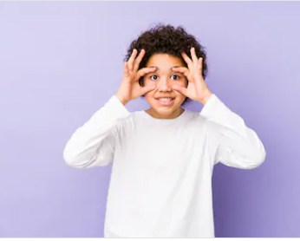
Change is an opportunity

Slide 8
How can you face change and be prepared?
Talk to friends and family about your concerns or excitement.
Be organised and get all of your equipment ready.
Learn the layout of your new school.
Know the timetable of your new school.
Know what uniform and sports kit you need.
Never be afraid to ask for help.

Slide 9
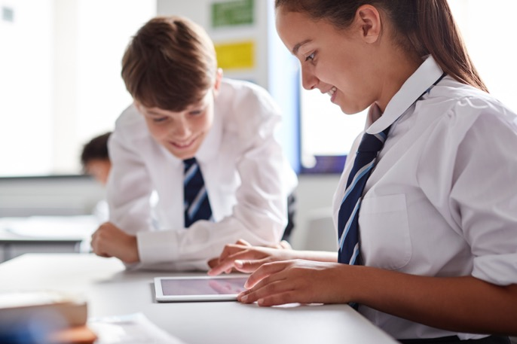
There are many ways we can embrace the
change of going to secondary school
See it as an opportunity to make new friends.
Try out new clubs and activities.
Everyone is facing the same thing so try to enjoy it!
Make a great first impression with your behaviour, organisation and presentation.

Slide 10
Why is getting an education such a great thing?
This is what a teenager called Malala said when she was at secondary school:
“One child, one teacher, one book, one pen can change the world.”
Malala Yousafzai
Pakistani activist for female education and the youngest Nobel Peace Prize laureate

Slide 11
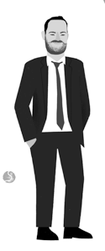
“Malala believes that anyone – you, me, that person on the bus who goes to the secondary down the road – can change the world. The power of education to help you do that is massive. It opens doors that we thought were locked; it gives us the bricks to build the highest tower from which we can see the beauty of the world. Or, to put it without using metaphors, a good education can help you get the life you want for yourself.’
‘Go Big’ page 14

Slide 12
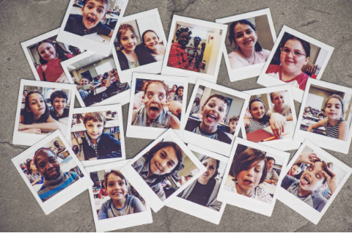
Activity: School memories
Before you make a change, it is good to look back as well as look forward. You can see how far you have come! You started primary school when you were just five years old – you couldn’t read or write back then!
Name three things that have changed the most since you started primary school.
What will you miss most about your old school?
What are you most concerned about in your new school?

Slide 13
“Throughout our lives we go through all sorts of changes, or what we call, ‘transitions’. One of the biggest transitions any of us will go through, though, is the leap from primary to secondary school.”
We are going to look at some of those changes.
‘Go Big’ page 19

Slide 14
There are many differences between primary and secondary school. Here is what to expect:
Primary | Secondary
Smaller school Same class all the way through school A smaller range of subjects The same teacher or a few teachers for an entire year Playtime activities to do It could be close to your home with friends nearby Less independence | Bigger school and you will move to different lessons Different subjects Different types of homework Different structure and routine Different teachers for each subject You will have a form tutor and class More independent learning Manage your own time A mixture of different children from different schools Different set of rules

Slide 15
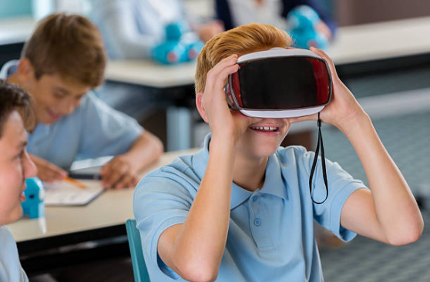
Activity: New school
Write down three things you are really excited about doing in secondary school.
Write down three worries you have about secondary school. Speak to someone you trust about your worries to help you feel better.

Slide 16

Life is a journey…
Build on who are and what you have done in primary school.
Use it as a stepping stone to help you achieve and enjoy a new school and environment.
In your workbook:
What are the things that you have already done at primary school that you would like to build on?
It is YOUR journey…

Slide 17
Here are some top tips for making the change:
When you go for your first day, ask people their names.
Be kind – everyone is nervous, we just display it in different ways.
Make yourself talk to new people.
Ask if you are not sure.
Be determined to make a good impression – be polite and have the right equipment.
Smile! Even your teacher will be nervous on the first day back!

Slide 18
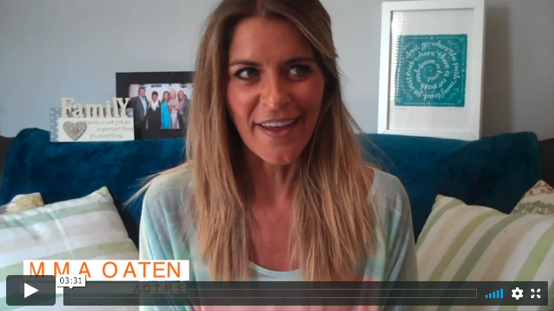
As an actress, Gemma has ‘first days’ a lot of the time when she is meeting new teams or cast members for the first time. She can help us with this!

Slide 19
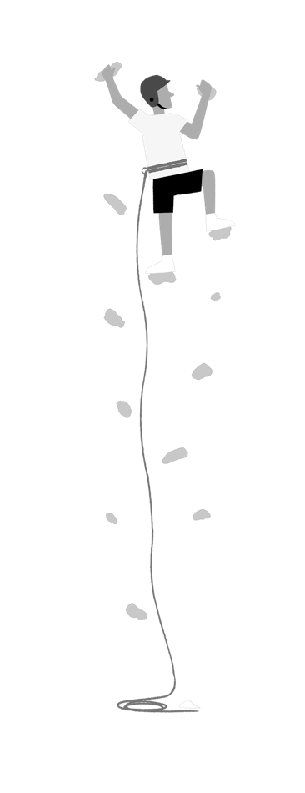
If you embrace the change, and use it as an opportunity to grow, then you will be able to do brilliant things!

Slide 20
© 2020 The PiXL Club Ltd and Hachette UK
This resource may be shared with any primary school Year 6 student in its current form, and parts thereof, to enhance your transition work with students. All opinions and contributions are those of the authors. The contents of this resource are not connected with, or endorsed by, any other company, organisation or institution.
If there are any inadvertent omissions or errors in the acknowledgements or usage, this is unintended and we will remedy these on written notification.
Hachette UK own 'You Are Awesome' by Matthew Syed and 'Go Big' by Matthew Burton, which may be purchased by individuals and schools, should they wish to do so to enhance these resources for students. 'You Are Awesome' illustrations copyright © Toby Triumph. 'Go Big' illustrations copyright © Chris Madden.

