Slide 1
Management and promotion roles
Learning Aim B: Understand job roles in the music industry
Lesson 8: 15th November 2016

Slide 2
What do we mean by management and promotion roles?
In groups, see if you can work out what the different roles involve.

Slide 3
Management and promotion roles
Artistic Management
Venue management
Studio management
Promoter
Marketing
A & r

Slide 4
Artistic Management
They are responsible for:
Personal and financial management
Advice and guidance
Liaising with recording companies
Arranging tours
Negotiating fees.

Slide 5
Venue Management
They are responsible for:
Booking events
Licensing
Managing of Staff
Management of publicity for events
Organizing the security for events
Health and safety of artist
Audience and staff

Slide 6
Studio Management
They are responsible for:
Booking sessions
Managing the maintenance of equipment and facilities.
Making sure that equipment is ‘up to date and ‘professional’, and fit for the artists to use.

Slide 7
Promoter
They are responsible for:
Identifying performance opportunities
Venues and artists
Securing finance for events
Manages financial risk
Insurance and safety

Slide 8
Marketing
They are responsible for:
Managing marketing materials and strategies.
How to sell the product and in what way.
This could be through different types of advertisement and when and where they should appear - (targeting an audience).
This is often a group of people and they help musicians promote their music through partnerships with concert tours, festivals/events and other live shows.

Slide 9
A&R
They are responsible for:
Scouting for talent online and at live events. This might be through watching trending videos on YouTube or even at local performances .
Record Companies such as Sony or EMI will have people that are solely dedicated to searching for “the next big thing”.

Slide 10
Guess the Job Role

Slide 11
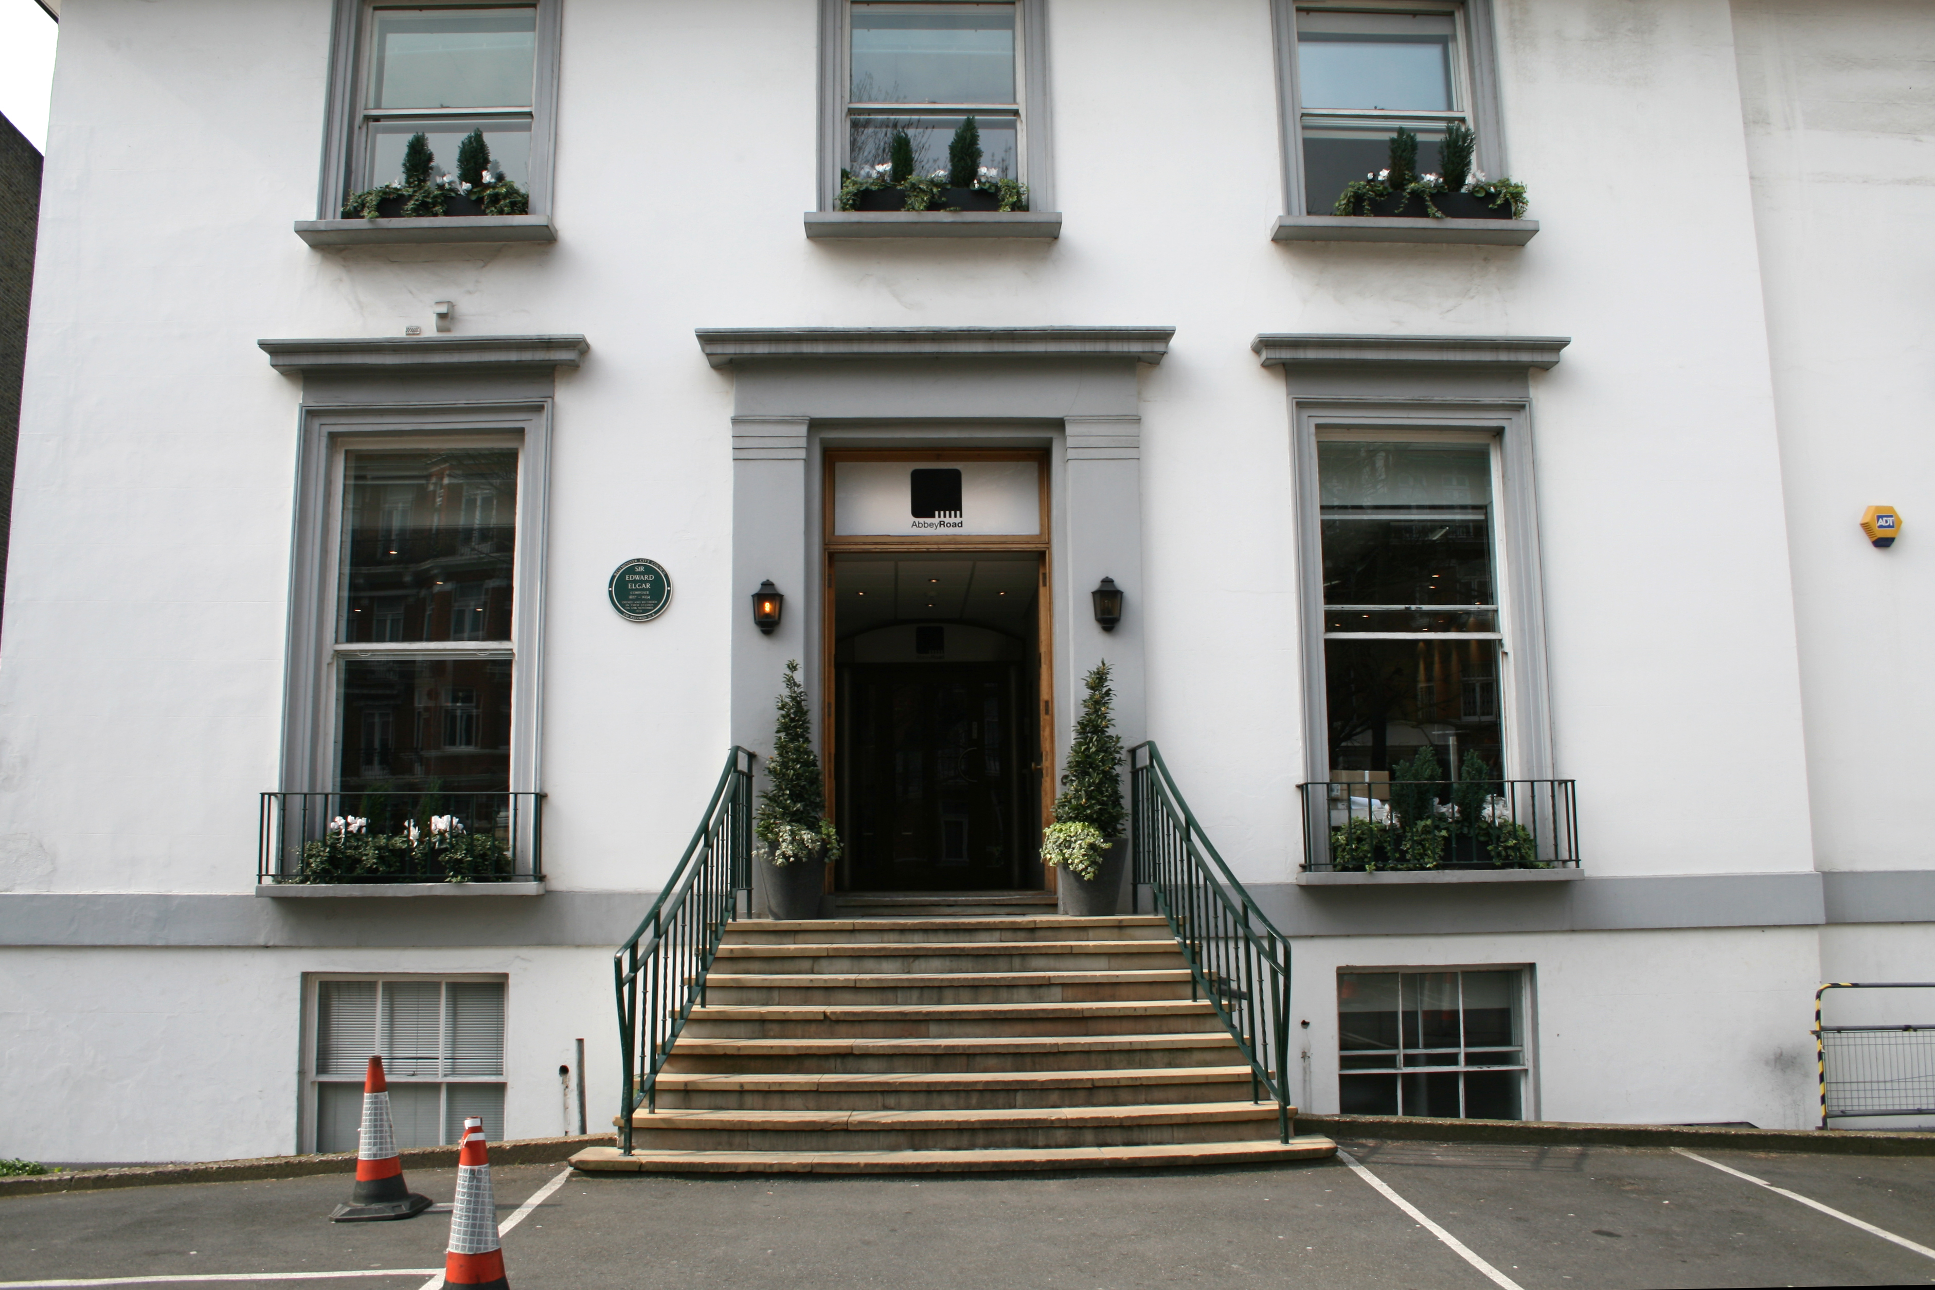
I might work in a place like this. I do things like book sessions and manage the maintenance of equipment and facilities.

Slide 12
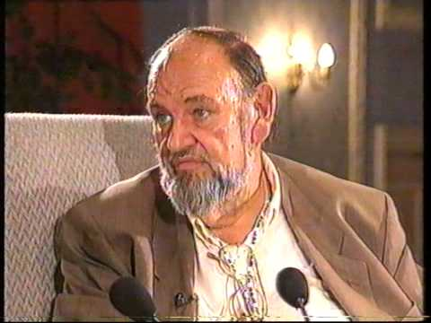
Peter Grant
I talk to bands give them advice and guidance regarding their careers. I arrange tours, liaise with record companies and negotiate appropriate fees for the bands under my guidance.

Slide 13
My Job is to ‘Scout for Talent’ online and at live events. Sometimes I watch what's trending YouTube and sometimes you might see me at gigs or concerts.

Slide 14
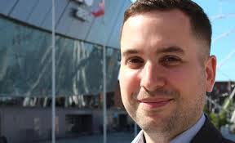
I work at the Liverpool Echo Arena.
My main responsibilities are to book events and ensure we hold necessary licenses, manage teams of staff including organising security for events, and ensure the health and safety for the audience and the artists is considered.

Slide 15
My role involves lots of research. I have to consider the target audience and create imaginative ways to get their interest. This sometimes involves getting their opinions about different things. I also have to work with the artist management to create an image, and keep to budgets

Slide 16
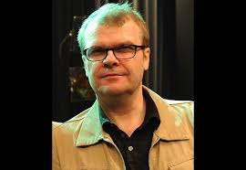
My main responsibilities include looking for performance opportunities. To do this I work with artists and venues to match them carefully. I also take financial risks and look for funding to cover costs for events

