Slide 1
Unit 1: The Music Industry (External Exam)
Learning Aim B:
Understand job roles in the music industry
Lesson 6: Performance/Creative roles
1st November 2016

Slide 2
Aims
Who is responsible for what activity?
Why and how are things done?
What are the advantages/disadvantages of relying on individuals for services?

Slide 3
Performance/Creative Roles
These are the roles that work together to make the live performance happen. They include:
Musician
Composer/Songwriter/Producer
Musical Director
Live Sound Technician
Roadie
Instrumental Support

Slide 4
Musician
Musicians are the:
Instrumentalists
Vocalists
Accompanists
DJs

Slide 5
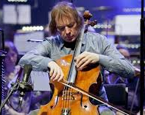
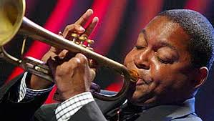
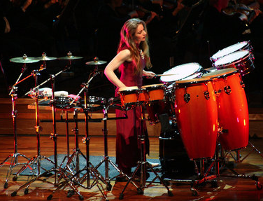
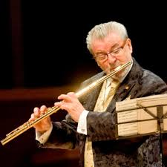
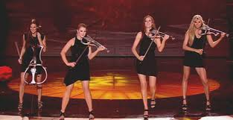
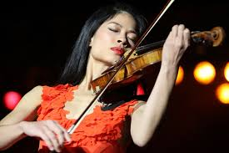
Julian Lloyd Webber
Wynton Marsalis
Instrumentalists
James Galway
Evelyn Glennie
Escala
Vanessa Mae

Slide 6
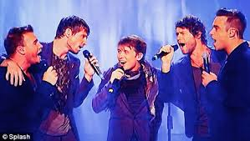
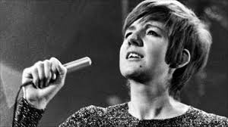
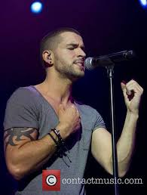
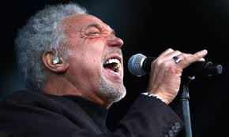
Take That
Cilla Black
Beyonce
Vocalists
Shayne Ward
Tom Jones
Girls Aloud

Slide 7
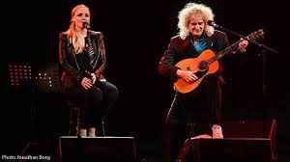
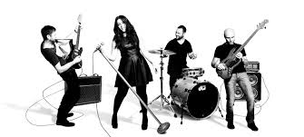
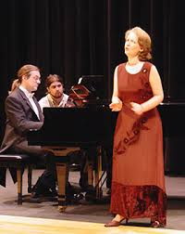
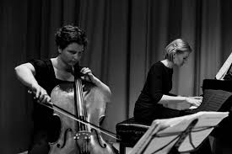
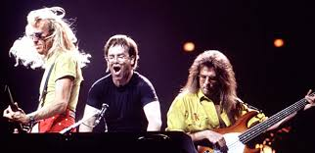
Accompanists

Slide 8
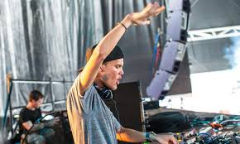
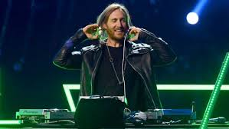
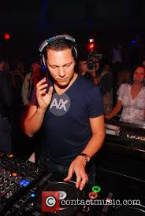
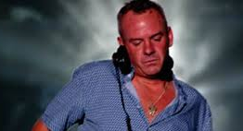
Avicii
David Guetta
DJs
Tiesto
Fat Boy Slim

Slide 9
Musician
Their roles include the following types of day-to-day activities:
Auditions – attend, do their best performance to get the job/gig
Rehearsals - attend technical rehearsals to practise the use of equipment as well as dress rehearsals (full rehearsal in costume etc)

Slide 10
Musician
They may also be expected to:
Participate in performances/workshops to share skills and creative ideas
Market/promote their own work eg media interviews etc
Can you think of any other tasks/activities they may be expected to do?

Slide 11
Composer/Songwriter/Producer
A composer is someone who writes original pieces of music. They have detailed knowledge and understanding of different instruments and can create music to their parameters – orchestrate music. A composer is usually an instrumentalist – often accomplished on many instruments.
A beat-maker is someone who uses computer software to arrange samples (small recorded sounds) and loops them to create an instrumental track – often with no intention for it to be played by live musicians

Slide 12
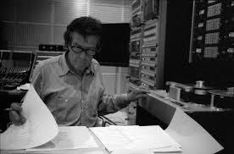
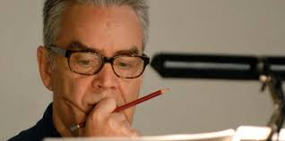
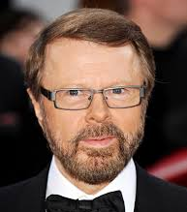
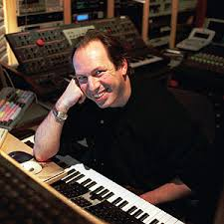
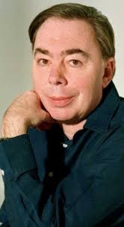
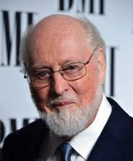
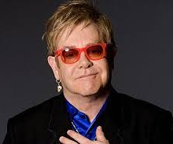
John Cage
Howard Shore
Bjorn Ulvaeus
Hans Zimmer
Composers
John Williams
Elton John
Andrew Lloyd Webber

Slide 13
Composer/Songwriter/Producer
A songwriter is similar to a composer, although they usually don’t have the music qualifications or the ability to write intricate, lengthy instrumental pieces, and stick to writing original songs.

Slide 14
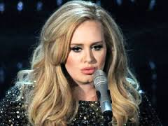
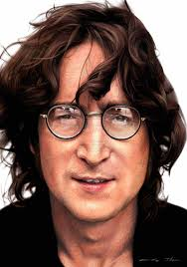
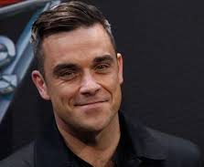
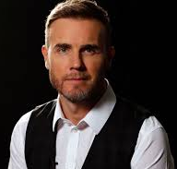
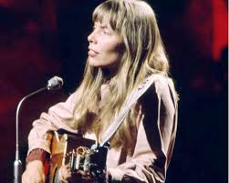
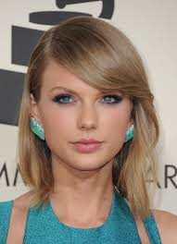
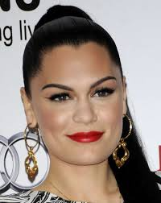
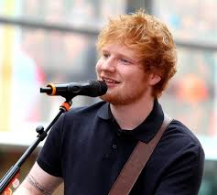
Adele
Robbie Williams
John Lennon
Songwriters
Gary Barlow
Joni Mitchell
Jessie J
Ed Sheeran
Taylor Swift

Slide 15
Composer/Songwriter/Producer
A producer is the person who has overall responsibility for the creative mix – what will be heard in the performance/on the CD. They generally have good skills for arranging music (taking an idea and using it in a different way), and using technology to realise (bring to life) music. Sometimes the producer is the same person who composed the piece/beat-maker. Sometimes artists write their songs and then use a separate producer to make the song sound better.

Slide 16
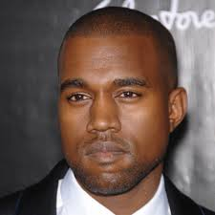
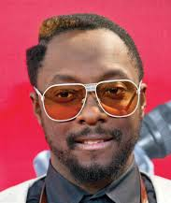
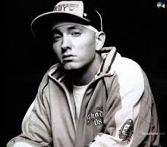
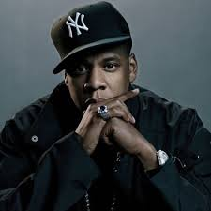
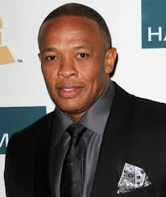
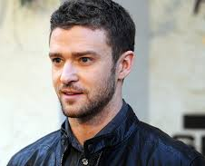
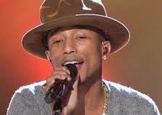
Kanye West
Eminem
Will I Am
Missy Elliot
Jay Z
Producers
Dr Dre
Pharell Williams
Justin Timberlake

Slide 17
Composer/Songwriter/Producer
Each of these roles require them to:
Respond to a brief
Pitch ideas to clients
Produce scores and/or parts
Promote their own work

Slide 18
Musical Director
The role of the musical director is to ensure that all involved in the performance know their part thoroughly to enable a performance of the highest quality.

Slide 19
Musical Director
To do this they can be expected to:
Communicate their creative interpretation
Conduct the ensemble – take charge of the expressive performance by hand/body movements
Arrange music/parts
Lead rehearsals – ensuring accuracy in the performance
Hire musicians – consideration to the musical demands and ensuring suitable skill levels

Slide 20
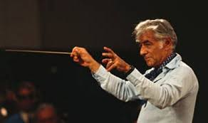
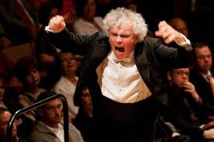
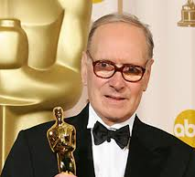
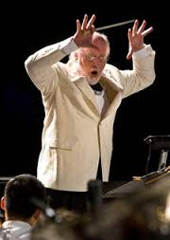
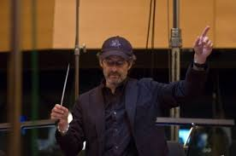
Leonard Bernstein
Simon Rattle
Musical Directors
Ennio Morricone
John Williams
James Horner

Slide 21
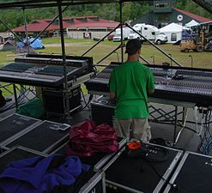
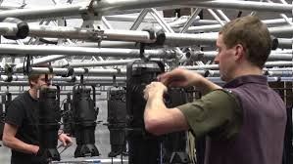
Sound Technician
A Sound Technician is involved in the live performance on a stage. It should not be confused with the role of a Sound Engineer who works in the Production area of the industry in a recording studio.

Slide 22
Sound Technician
The roles of a sound technician can include:
Stage planning (location of equipment)
Rigging/De-rigging (setting up and packing away technical equipment eg amps/mics/leads/speakers/monitors etc)
Supervising crew members
Carry out sound checks
Ensure microphones/lines work correctly
Adjust levels as necessary during the live performance
Carry out on-stage mixes (balance sounds from different instruments/parts)
Carry out front of house (FOH) and monitor mixing (audience and performer speaker balance)

Slide 23
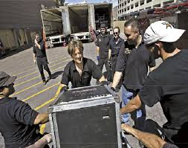
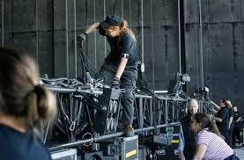
Roadie
The role of a roadie is sometimes under-rated. However their role is crucial to allow a technical rehearsal to take place and can be the difference between a fantastic or a poor performance.

Slide 24
Roadie
They will:
Help with the ‘get-in’ and ‘get-out’ – loading/unloading, unpacking/packing of equipment and instruments
Assist with rigging/de-rigging
Provide specialist instrumental support eg guitar technician/drum tech
Drive/transport equipment

