Slide 1
Unit 1: The Music Industry (External Exam)
Learning Aim A:
Understand different types of organisations that make up the music industry
Lesson 5: Unions (18th October 2016)

Slide 2
UNIONS
A trade union is formed when workers join together to pursue policies and goals beneficial to one and all. In other words, a union is you and your fellow workers, acting together to better your everyday working conditions.
A union is a professional body that offer advice, guidance and support to their members.
Unions are democratic organisations representing a group of individuals who are workers in a particular industry or industries. They aim to improve the working lives of its members and represent their interests at a range of levels. To achieve these aims unions may, for example: negotiate with employers, organise industrial action, set minimum pay levels, lobby government departments and ministers, take up legal claims and provide a range of services to their members.
You have to pay a monthly subscription to be a member of a union.

Slide 3
UNIONS
Examples of unions for the music industry are:
Musicians’ Union (MU)
Equity
Broadcast Entertainment Cinematograph Theatre Union (BECTU)

Slide 4
Musicians’ Union (MU)
The members of this union are generally:
Musicians
Composers
Instrumental teachers

Slide 5
Equity
This union covers:
Actors
Dancers
Other performers

Slide 6
Broadcast Entertainment Cinematograph Theatre Union (BECTU)
This union covers people working in production and/or technical roles eg.
Sound technicians
Lighting technicians
Camera operators

Slide 7
UNION SUPPORT
TASK
Work in pairs. Create a list of ways in which you think a union can support or help their members?

Slide 8
UNION SUPPORT
Monitor employment conditions and contracts between employees and employers.
Make sure the contract is fair/reasonable for all parties
Support if one party breaks the contract – doesn’t do as expected/agreed in the contract

Slide 9
UNION SUPPORT
Advice for freelancers on tax and National Insurance.
Support in obtaining the correct paperwork
Support in completing paperwork
Guidance on what you would expect to pay

Slide 10
UNION SUPPORT
Negotiate minimum rates of pay and working conditions.
Speak to your employers for you to ensure
you are paid a fair wage for your work
your hours of work are reasonable
your working environment is safe
etc

Slide 11
UNION SUPPORT
Handle disputes.
Listen to your concerns and advise you
Speak on your behalf
Give you legal advice/employ a solicitor to act for you

Slide 12
UNION SUPPORT
Other services.
Eg
Campaigning
Provide networking opportunities
Give career/business advice
Provide information about insurance (eg Accident and Sickness insurance/Public Liability insurance/Instrument or equipment protection)/pensions and pension schemes
Keep you updated about changes to relevant legislation/laws
Provide training opportunities

Slide 13
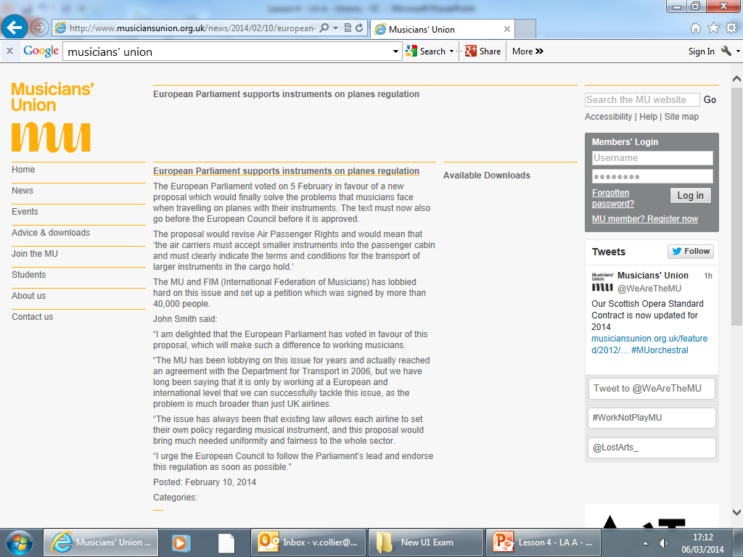

Slide 14
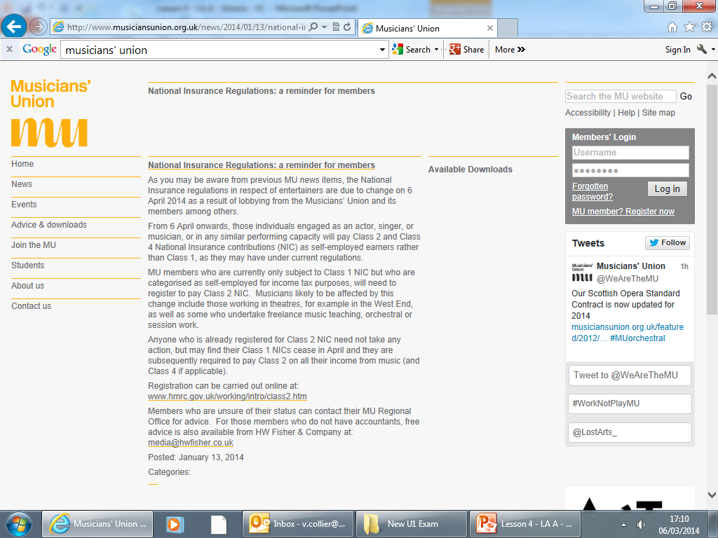

Slide 15
Task
Use the example orchestral agreement to work out the pay for the following:
Principle instrumentalist in Bath Philharmonic
Extra rehearsal on another day (less than 3 hrs)
Violin and Cello required
Travel expenses to venue 120 miles – transport provided
Travel including plane journey
Overnight stay – accommodation provided
Porterage – transportation of large instrument
Total Pay £

Slide 16
Task
Use the example orchestral agreement to work out the pay for the following:
Principle instrumentalist in Bath Philharmonic
2a £105.55
Extra rehearsal on another day (less than 3 hrs)
3b £63.33
Violin and Cello required
5 £10.50
Travel expenses to venue 120 miles – transport provided
6b £18.00
Travel including plane journey
6c £22.40
Overnight stay – accommodation provided
7a £61.90
Porterage – transportation of large instrument
8 £10.30
Total Pay £291.98

