Slide 1
Getting Started and Getting Paid
Unit 1: The Music Industry
(External Exam)
Lesson 10: 29th November 2016

Slide 2
Getting Started.

Slide 3
https://www.youtube.com/watch?v=KWf9CgJS2gI

Slide 4
How did Ed Sheeran get into ‘The Business?”
Sheeran was born in Hebden Bridge near Halifax, West Yorkshire but moved to Framlingham, Suffolk as a child.
He has a musical family, as his brother is a Classical Composer and Postgraduate music student.
He sang in a local church choir from the age of four, learned guitar at a very young age, and began writing songs during his time at High School.
His rise to fame is largely due to touring smaller venues in London and building a steady following.

Slide 5
If you were an artist like Ed Sheeran, what would be your ’10 Point Plan’ to being successful in the music industry?

Slide 6
If you were an artist like Ed Sheeran, what would be your 10 point plan to being successful in the music industry.
Be passionate, hard-working, resilient, patient, and don’t give-up.
Have an instrumental/vocal coach to guide your technique & musical skills.
Do voluntary concerts in local venues (bars, theatres etc.) to gain experience & put on your CV.
Send examples of your work (demo’s) to music agents, record labels & publishers (if you compose/write your music)
Use social media to promote yourself (YouTube, Sound Cloud, blogs, Facebook etc.)

Slide 7
Create your own personal style (music and clothes) that make you stand out.
Sign contracts with caution and read the small-print (have a lawyer/solicitor for advice) or join a union.
Find an agent/manager who will cater to your musical needs & requirements, making sure that you get the right ‘gigs’ or interviews.
Take care of yourself (healthy lifestyle). This is particularly important for singers, who have to be very careful not to damage their voice.
Network as much as possible (social media, playing as a preceding act for more famous artists)

Slide 8
Getting Paid!

Slide 9
3 Main Ways to GET PAID
When you agree to perform at an event you should discuss the terms of the performance (eg how long performing for, start time, breaks, etc) as well as the payment.
Early in your career it might be that you agree to perform for FREE – this builds your fan-base, builds your reputation and you gain vital experience.
For many performance situations it will be a simple payment process of payment following performance:

Slide 10
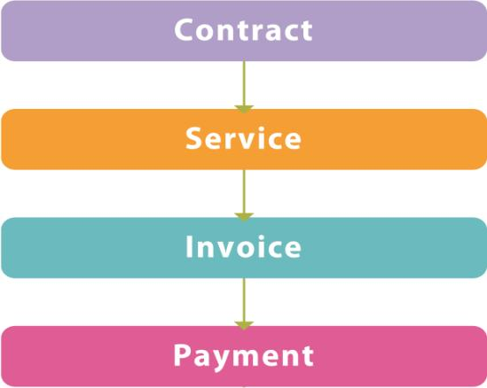
PAYMENT TYPE 1
This flow chart shows a simple contract operation. This features in the music industry and also in many circumstances in other businesses. This system is too simplistic for large contracts but is often used for casual work, temporary staff contracts, service contracts for catering and transport, and so on.

Slide 11
PAYMENT TYPE 2
This flow chart is the sort of thing that was used before the Internet when the music industry was all about selling copies of CDs and vinyl. Here the artist might receive a lump sum at the start of the contract. This would be taken off the settlement, which would be paid at the end. The agency doing the contracting would have to be confident that the settlement would be large enough to pay off the advance. In many cases it wasn’t, and the artist would have to pay the advance back from other earnings, sometimes over many years.
Advances (where some of the payment is paid before the contracted work has been done) are still available but the recoupment (claiming an artist’s advance back from them) is no longer based solely on CD and album sales, but more often on tickets and live performance fees. Performing rights and other aspects such as merchandise and endorsements are also factored in.

Slide 12
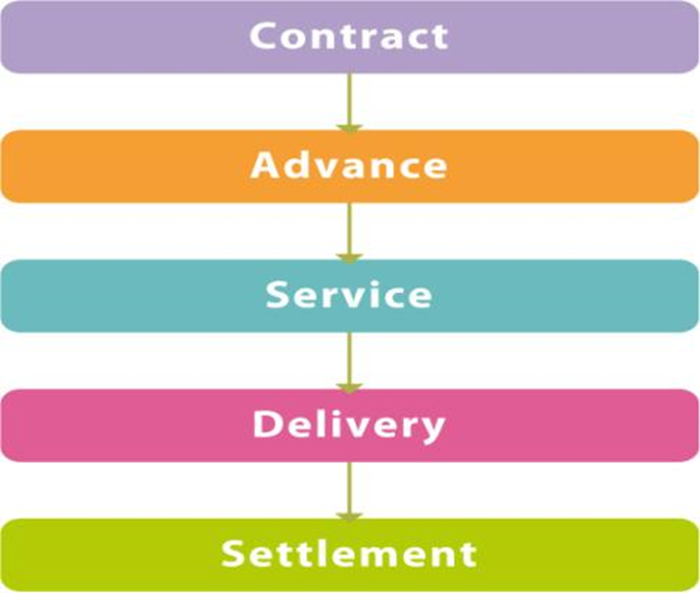
PAYMENT TYPE 2 Continued

Slide 13
PAYMENT TYPE 3
Composers and creators of music often have a part of the negotiation process formally in place before the contract is issued. This is the pitch, where the artist presents ideas in response to a brief or suggestion from a company.
If the artist's ideas are acceptable, then the negotiation and contracting starts.
This is great for businesses that get the artists to do work for free before there is any promise of payment, and clearly a problem for artists who are unsuccessful. However, it is a standard model in many fields and something that is built into the costs of the service.

Slide 14
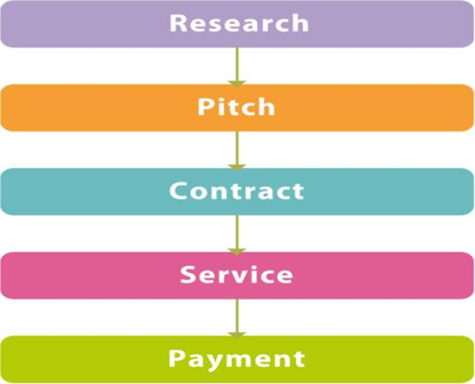
PAYMENT TYPE 3 Continued

Slide 15
TASK
Work with a partner.
Take it in turns to select a job role from the Music Industry that we have looked at over the last few weeks. You should consider which type of payment they would be likely to use.
List the job role, the payment type and your reasons in a table.
Job Role | Payment Type | Reason

